Slide 2
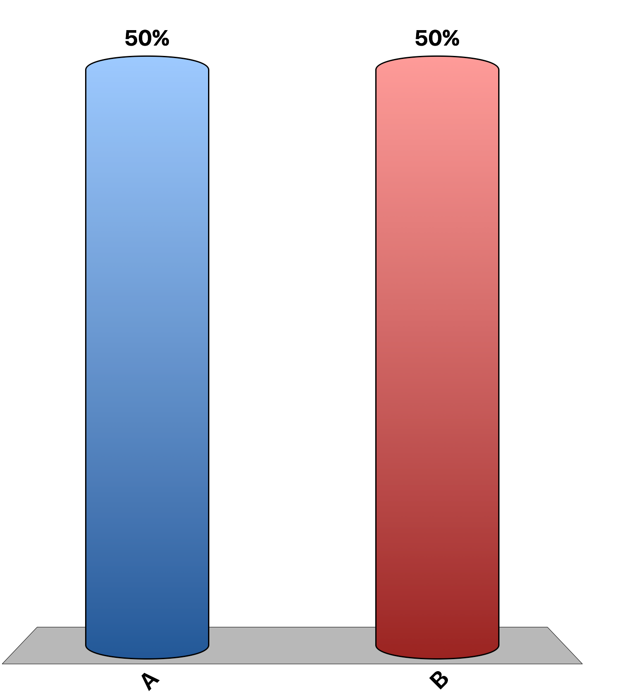
If a country has an absolute advantage in producing a good, then it must also have a comparative advantage in producing that good.
True
False

Slide 3
If a country has comparative advantage in producing a good, then the other country has comparative advantage in producing the other good.
True
False

Slide 4
International trade can make some individuals worse off, even as it makes the country as a whole better off.
True
False

Slide 5
Countries specialize in the production of the good they can produce at the highest opportunity cost.
True
False

Slide 6
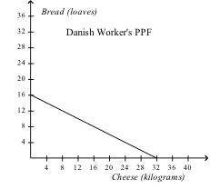
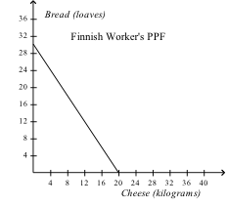
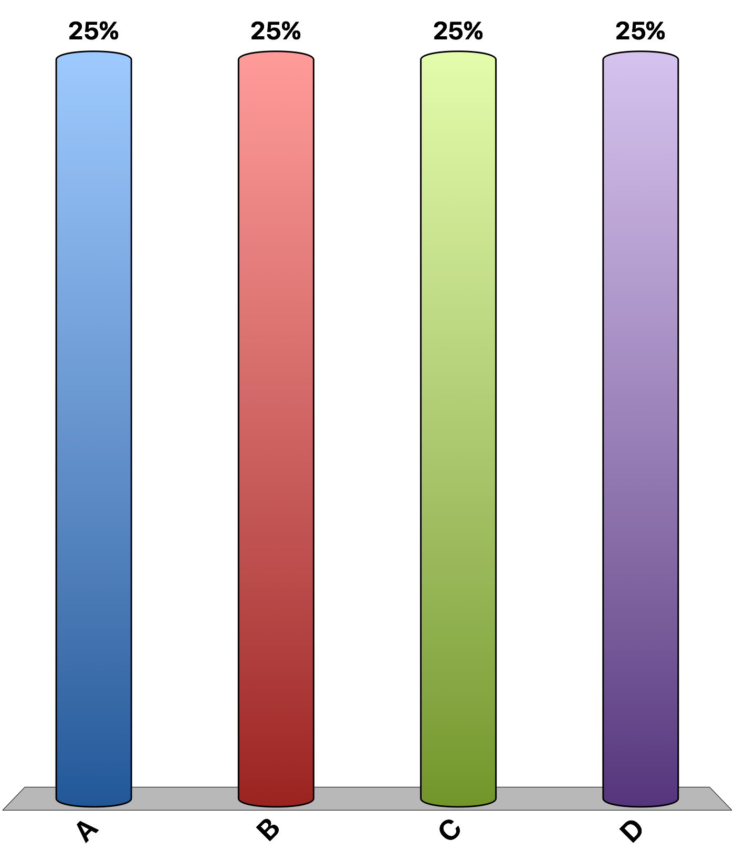
Refer to the figures above. What is the opportunity cost of a pound of cheese in Denmark?
2 loaves of bread
3/2 loaves of bread
2/3 loaves of bread
1/2 loaves of bread

Slide 7
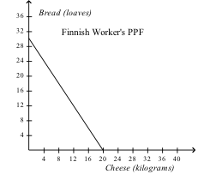
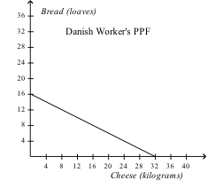
Refer to the figures above. Which country has the absolute advantage in producing cheese and which has the comparative advantage producing cheese?
Denmark, Denmark
Denmark, Finland
Finland, Denmark
Denmark, Finland

Slide 8
Refer to the figures above. Suppose these two countries trade only with each other. With no trade restrictions in effect, what kind of trade, if any, would occur?
Denmark would sell cheese and bread to Finland.
Denmark would buy cheese and bread from Finland.
Denmark would sell cheese to and buy bread from Finland.
Denmark would buy cheese from and sell bread to Finland.

Slide 9
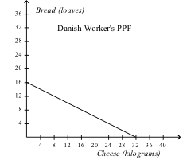
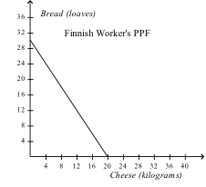
Refer to the figures above. If these two countries were to trade, a possible exchange rate would be 1 loaf of bread for
5/2 kilograms of cheese.
3/2 kilograms of cheese.
2/5 kilograms of cheese.
1/2 kilograms of cheese.

Slide 10
Refer to the table above. The opportunity cost of a pound of coffee in Argentina is
3 bu. of wheat.
5/2 bu. of wheat.
2/5 bu. of wheat.
1/3 bu. of wheat.

Slide 11
Refer to the table above. Which country has the absolute advantage in wheat and which has the comparative advantage in wheat?
Argentina has the absolute advantage, Brazil has the comparative advantage.
Brazil has the absolute advantage, Argentina has the comparative advantage.
Argentina has the absolute and comparative advantage.
Brazil has the absolute and comparative advantage.

Slide 12
Refer to the table above. Suppose these two countries trade with each other but no other countries. With no trade restrictions in effect, what kind of trade if any would occur?
Argentina would export coffee and wheat.
Argentina would import coffee and wheat.
Argentina would export coffee and import wheat.
Argentina would import coffee and export wheat.

Slide 13
Refer to the table above. If these two countries were to trade, a possible exchange rate would be 1 lb. of coffee to
2/5 bu. of wheat.
2/3 bu. of wheat.
5/2 bu. of wheat.
7/2 bu. of wheat.

Slide 14
Suppose that France has a comparative advantage in the production of Camembert cheese and that Spain has a comparative advantage in the production of oranges. If the two countries do not trade with any countries but then agree to trade with each other, which of the following will be true concerning French and Spanish consumption possibilities?
They will be unchanged.
France and Spain can each consume more oranges, but not more cheese.
France and Spain can each consume more cheese, but not more oranges.
France and Spain can each consume more cheese and more oranges.

Slide 15
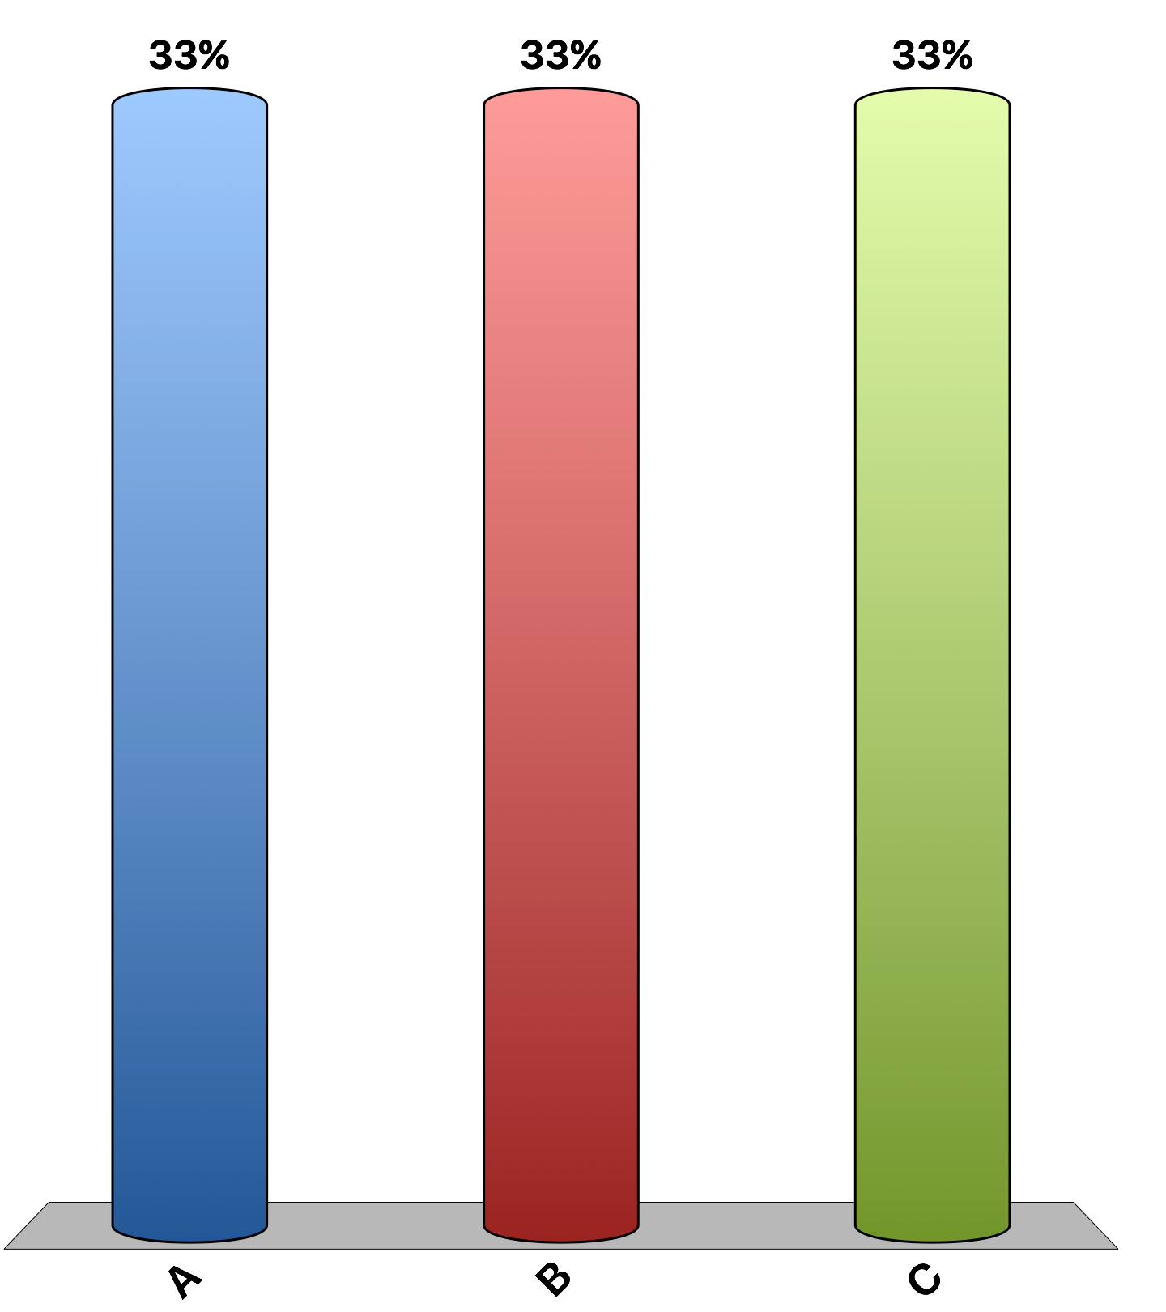
“Trade with China makes most Americans better off because, among other advantages, they can buy goods that are made or assembled more cheaply in China.”
agree
disagree
uncertain
Notes:
100% of economists agree with that statement. This is the 'Ask the experts' feature in the textbook. Source: IGM Economic Experts Panel, June 19, 2012.

Slide 16
“Some Americans who work in the production of competing goods, such as clothing and furniture, are made worse off by trade with China.”
agree
disagree
undecided
Notes:
96% of economists agree, and 4% are uncertain. This is the 'Ask the experts' feature in the textbook. Source: IGM Economic Experts Panel, June 19, 2012.

